Slide 1
Progressive Movement and the lasting impact It had on American Society

Slide 2

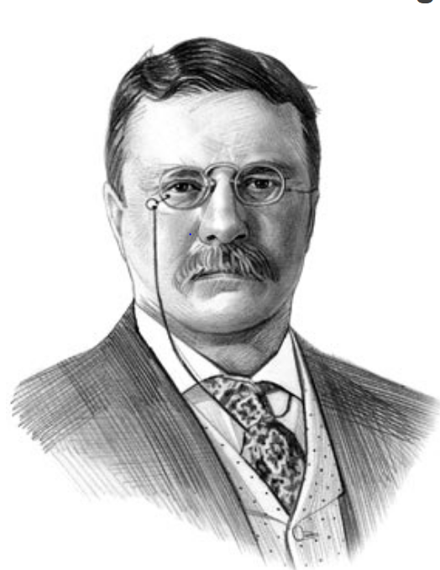
Introduction
  Progressive movement- leading intellectuals and social reformists facilitated social, political, and economic reforms.
Notes:
The Progressive Movement encompassed a variety of different ideas and activities of reformist pressure groups. The Progressive Era was the period in the history of the United States that was dominated by reform ideals from 1890 - 1920. The Progressive Movement covered social reform issues relating to female suffrage, education, working conditions, unionization, the problems of urbanization, industrialization and child labor. The Progressive Movement called for political reforms attacking bribery and corruption, the political machines and the regulation of Big Business and corporations and reducing the power of the Robber Barons and unfair business practices.
The movement rose during the reign of President Theodore Roosevelt and continued under the presidencies of President Taft and President Wilson.

Slide 3
Regulation of business
Regulation of monopolies
Equal competition among business entities
Laws protecting workers and consumers
Notes:
They progressive movement regulation of monopolies (“trust-busting”) and corporations through antitrust laws. These antitrust laws were seen as a way to promote equal competition for the advantage of legitimate competitors. The main statutes are the Sherman Act of 1890, the Clayton Act of 1914, and the Federal Trade Commission Act of 1914.
The Clayton law identified specific illegal practices and business combinations that were against the law if they tended to lessen competition or create a monopoly. Some of these illegal activities included:
Price discrimination, which is charging different consumers different prices
Tie-in contracts, by which a merchant could buy goods from a company only if it would not handle the products for that company's competitors
Certain holding companies, where a company buys enough voting stock in different companies to be able to control them
Interlocking directorates - one or more people serve on the board of directors of several companies
These laws have continued to impact the American society as businesses remain in check; just the other day, AT&T wanted T-Mobile’s cellular airwaves for faster services for smartphones (aka the iPhone). But AT&T had to back-off from becoming the nation’s biggest cell phone service provider because the Obama administration and the Justice Department threatened to sue the company on grounds of a “trust” that would corner consumers in paying high prices while reducing innovation

Slide 4
Greater Democracy
Direct election of senators
Primary elections gave the people more direct control over the government
The institution of the initiative and referendums made it possible to pass laws without the involvement of the legislature
The recall allowed for the removal of corrupt or under-performing officials
Notes:
The progressive movement primarily targeted political machines and their bosses. By taking down these corrupt representatives in office, a further means of direct democracy would be established.
The seventeenth amendment during the progressivism era provided for the direct election of senators. Before this was passed, senators were being appointed by state legislatures; the amendment thus facilitated greater democracy by giving the voters the ability to select their senators directly.
Before primary elections were introduced, party candidates were being selected by party activists in caucuses and conventions. Only a few people had a say in the process. Primary elections allowed the party membership in general to vote on who would represent the party and this was an extension of democracy which is still practiced in the America today.
An initiative (also known as a “popular” or “citizens'” initiative) is a means by which a petition signed by a certain minimum number of registered voters can force a public vote (plebiscite).
The initiative may take the form of a direct initiative or an indirect initiative. In a direct initiative, a measure is put directly to a vote after being submitted by a petition. In an indirect initiative, a measure is first referred to the legislature, and then put to a popular vote only if not enacted by the legislature.
A referendum is a direct vote in which an entire electorate is asked to vote on a particular proposal, which is the result of a successful initiative. This may result in the adoption of a new law.
A recall election is a procedure by which voters can remove an elected official from office through a direct vote before his or her term has ended. Recalls are initiated when sufficient voters sign a petition.

Slide 5
Conservationism
Natural resources were heavily exploited in the mid to late 19th century
Americans developed a "tradition of waste”
President Theodore Roosevelt, a progressivist, put an end to wasteful uses of raw materials.
He created an environmental conservation movement
The movement’s words and actions continue to be heard and felt throughout the nation today.
Notes:
In the mid to late 19th century, natural resources were heavily exploited, especially in the West. Land speculators and developers took over large tracts of forests and grazing land. Acreage important to waterpower was seized by private concerns. Mining companies practiced improper and wasteful mining practices. Assuming a seemingly inexhaustible supply of natural resources, Americans developed a "tradition of waste.“
Alarmed by the public's attitude toward natural resources as well as the exploitation of natural resources for private gain, conservationists called for federal supervision of the nation's resources and the preservation of those resources for future generations. In President Theodore Roosevelt, the conservationists found a sympathetic ear and man of action. Conservation of the nation's resources, putting an end to wasteful uses of raw materials, and the reclamation of large areas of neglected land have been identified as some of the major achievements of the Roosevelt era.

Slide 6
Rise of Professionalism
Progressive activists supported reforms in the professions of the local government.
They transformed and professionalized the social sciences.
In academics, amateur authors were transformed to research professors.
Notes:
Many activists joined efforts to reform local government, public education, medicine, finance, insurance, industry, railroads, churches, and many other areas. Progressives transformed, professionalized, and made “scientific” the social sciences, especially history, economics, and political science. In academic fields, the day of the amateur author gave way to the research professor who published in the new scholarly journals and presses.
One example of Progressive reform was the rise of the city-manager system, in which paid, professional engineers ran the day-to-day affairs of city governments under guidelines established by elected city councils. Many cities created municipal “reference bureaus,” which did expert surveys of government departments looking for waste and inefficiency.

Slide 7
Prohibition
The movement grew in the Progressive Era, when social problems such as poverty and drunkenness gained public attention.
Use of alcohol was often associated with such social ills as poverty and insanity.
There was a nationwide constitutional ban on the production and sale of alcoholic beverages.
Progressive reformists supported the prohibition to destroy the political power of local bosses based in saloons.
Notes:
The Eighteenth Amendment to the Constitution prohibited the manufacture, sale, or transport of alcoholic beverages. It was the product of a temperance movement that began in the 1830s. The movement grew in the Progressive Era, when social problems such as poverty and drunkenness gained public attention. Groups like the National Woman’s Christian Temperance Union, founded in 1874 and led by Frances Willard, made prohibition a national issue and pressed Congress for action.
Prohibition exhibited many of the characteristics of most progressive reforms. That is, it was concerned with the moral fabric of society; it was supported primarily by the middle classes; and it was aimed at controlling the "interests" (liquor distillers) and their connections with venal and corrupt politicians in city, state, and national governments. Still, it was not until U.S. entry into the Great War that prohibitionists were able to secure enactment of national legislation. In 1918, Congress passed the 18th Amendment to the Constitution, prohibiting the manufacture, transportation, and sale of alcoholic beverages. States ratified the Amendment the next year.

Slide 8
References
Croly, H. (2017). Progressive democracy. Routledge.
DeWitt, B. P. (2017). The progressive movement: A non-partisan comprehensive discussion of current tendencies in American politics. Routledge.
Leuchtenburg, W. E. (1952). Progressivism and Imperialism: The Progressive Movement and American Foreign Policy, 1898-1916. The Mississippi Valley Historical Review, 39(3), 483-504.

